Slide 1
The Structure & Function of DNA, RNA, and protein.
MT: Protein Synthesis

Slide 2
Big Picture of Protein Synthesis
Protein synthesis = making a protein
DNA then
mRNA then
Protein!

Slide 3
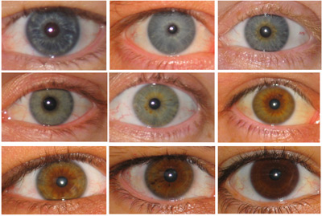
Function of DNA
Deoxyribonucleic Acid
Sequence of molecules that are the instructions for making proteins (which give us our phenotypes!)

Slide 4
Structure of DNA
DNA Nucleotide
Phosphate
Base
Adenine
Sugar
Thymine
Guanine
Cytosine
Deoxyribose

Slide 5
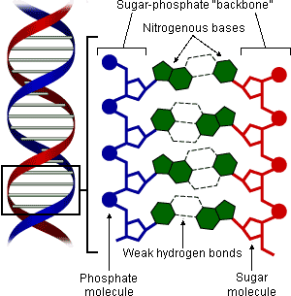

Slide 6
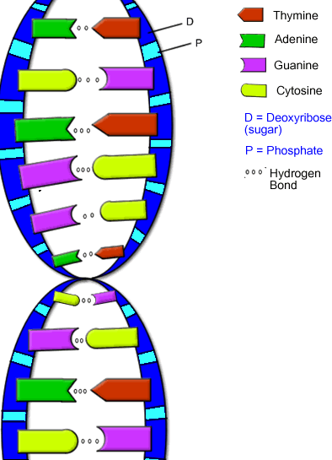
Shape of DNA
Double helix = 2 coiled strands
Anti-parallel to each other
One strand goes up and one goes down
Bases held together by hydrogen bonds

Slide 7
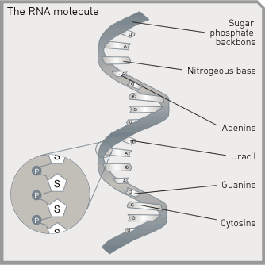
Function of RNA
Ribonucleic Acid
Copy of DNA which is decoded to make protein

Slide 8
Structure of RNA
RNA Nucleotide
Phosphate
Base
Adenine
Sugar
Uracil
Guanine
Cytosine
Ribose

Slide 9
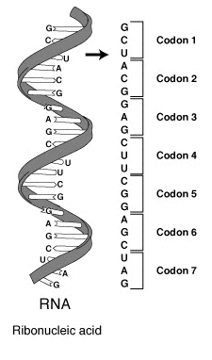
Shape of RNA
Single helix = 1 coiled strand

Slide 10
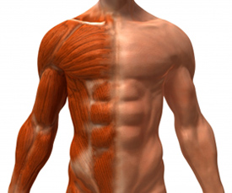
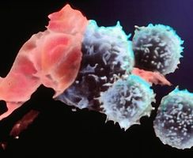
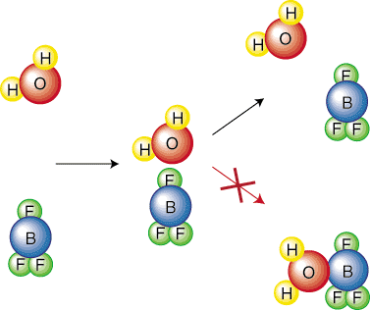
Function of Protein
Help with chemical reactions in body
Gives organisms their phenotypes
Builds muscles
Repairs damaged tissue
Fight off infections in body

Slide 11
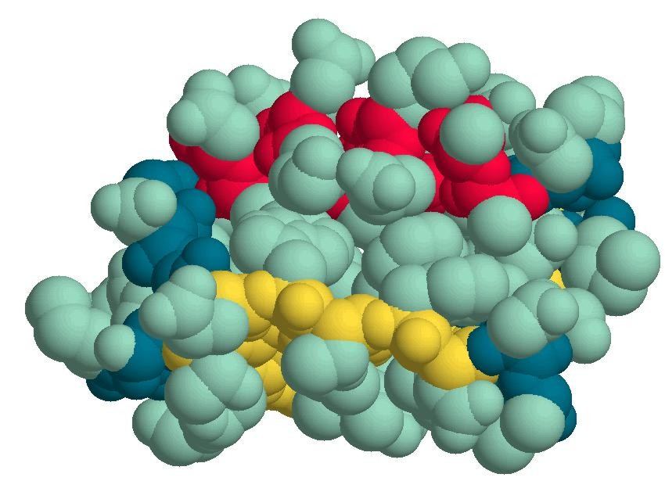
Structure of Protein
Chain of amino acids

