Slide 1
Population Size and Diversity
MT Evolution

Slide 2
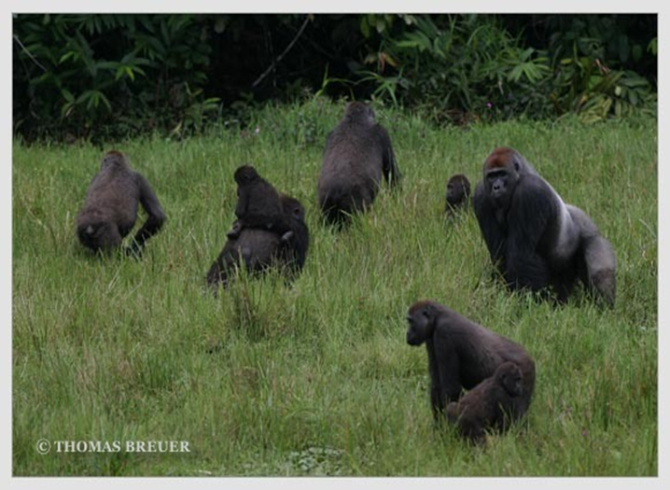
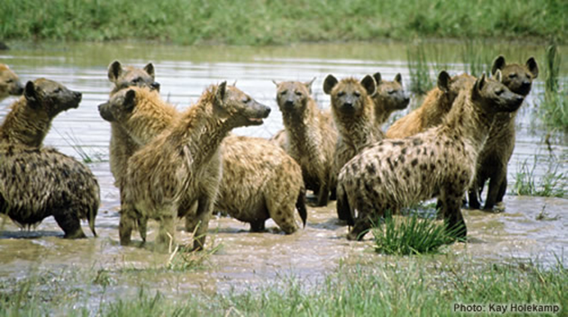
Review: Population
A group of the same species that lives in the same area

Slide 3
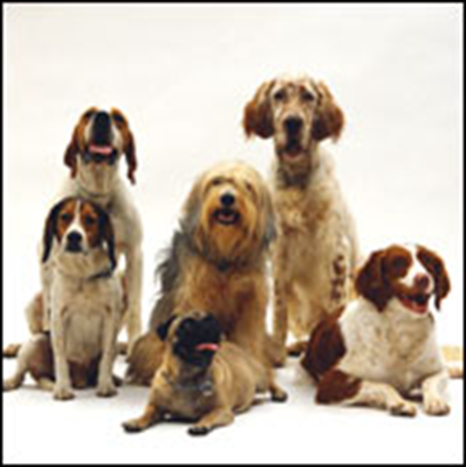
Review: Diversity
differences

Slide 4
Quickwrite:
Which population would have less diversity:
all of the hares in California or
all of the hares in Lindsay?
Explain in writing

Slide 5
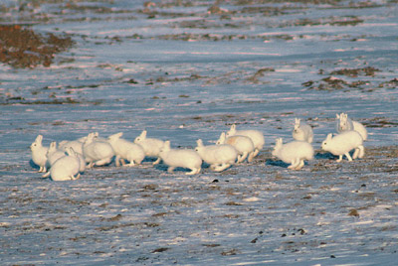
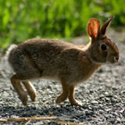
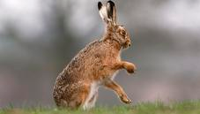
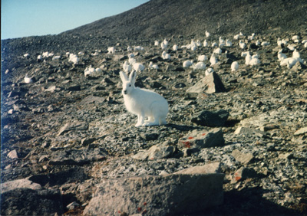
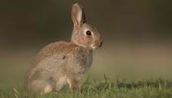
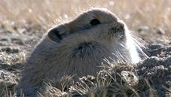
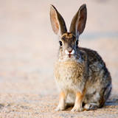
Hares in California
Hares in Lindsay

Slide 6
Connection:
Decrease Population Size = Decrease in Diversity
The smaller the population is, the smaller the chance of having diversity. There are less individuals, thus they tend to be similar. On the hand, the larger the population is, the greater the chance of having diversity. There are more individuals, thus more chance for differences.

