Slide 1
Hormonal Regulation of Testosterone
MT: Male Reproductive System

Slide 2
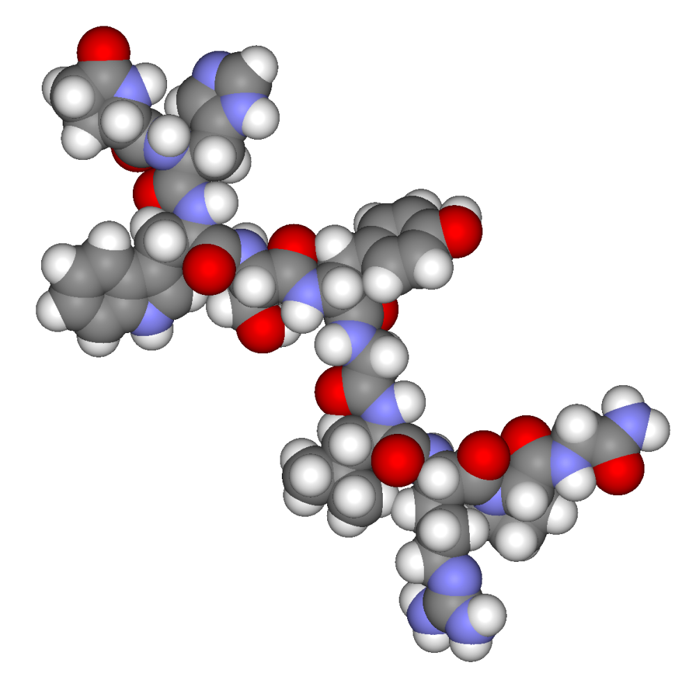
Hormones involved
GnRH: Gonadotropin Releasing Hormone
FSH: Follicle Stimulating Hormone
LH: Lutenizing Hormone
Inhibin
Testosterone

Slide 3
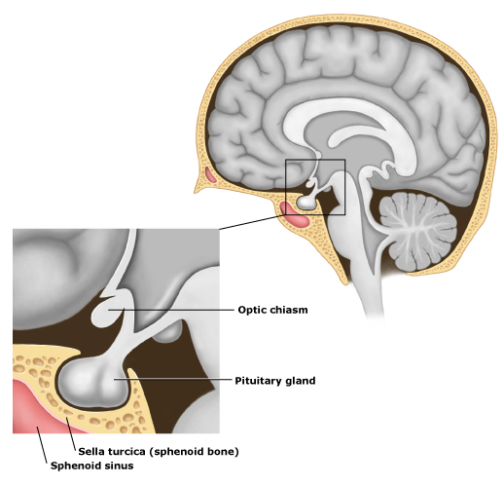
Parts involved
Hypothalamus
Anterior Pituitary Gland
Blood
Testes (seminiferous tubules)

Slide 4
Steps of hormonal regulation of testosterone
GnRH is released from hypothalamus and travels to anterior pituitary gland
FSH is released in blood from anterior pituitary gland
LH is released in blood from anterior pituitary gland
FSH acts on seminiferous tubules to increase spermatogenesis and to release inhibin
LH travels to testes to stimulate creation of testosterone
Testosterone travels in blood to hypothalamus to decrease release of GnRH
Inhibin travels to hypothalamus to inhibit the release of GnRH
Results in decrease amount of testosterone

Slide 5
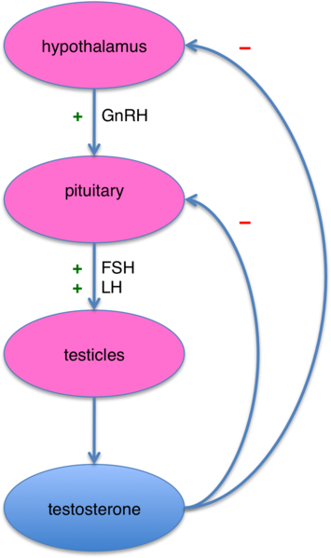
Negative Feedback

