Slide 1
Genetic Variation
MT: Allele Frequency

Slide 2
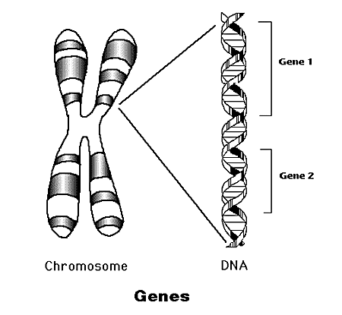
Genetic means
Genes
DNA

Slide 3
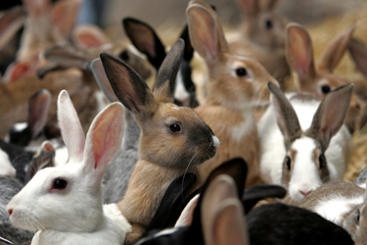
Variation means:
Differences
variety

Slide 4
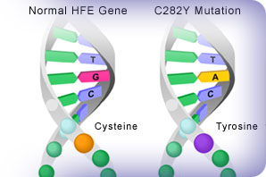
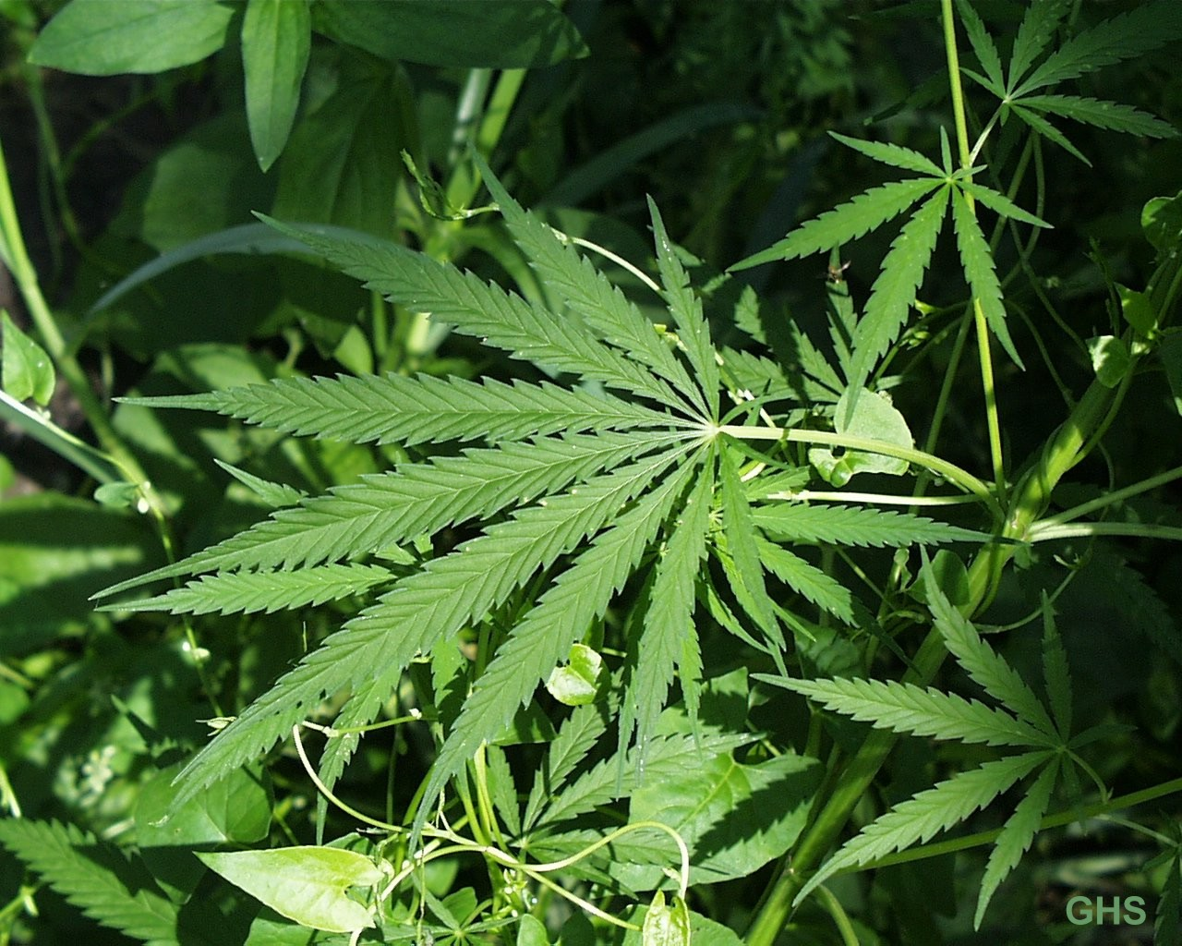
What causes genetic variation?
A MUTATION:
A change in DNA sequence
Occur naturally or via chemicals or radiation

Slide 5
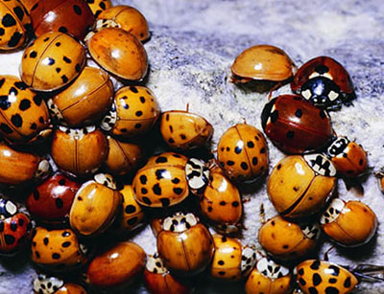
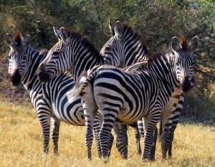
Quickwrite: Why is genetic variation important to a population?

Slide 6
Answer:
If there is genetic variation, then some individuals in a species will be more fit than others. This ensures that some individuals of the population will survive if there are changes in the environment.
If there is no genetic variation, then all individuals will be exactly the same. This could be deadly if there is a change in the environment. The population could be less fit to survive and reproduce.

Slide 7
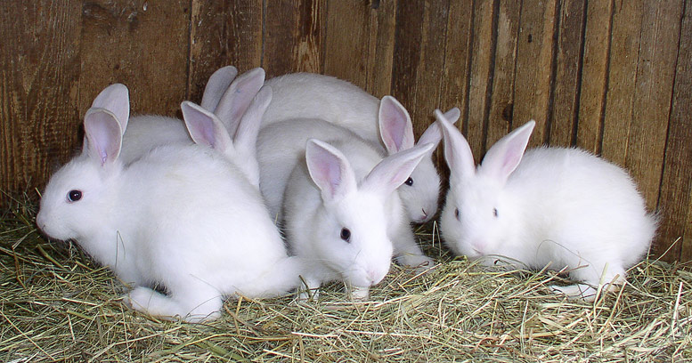
Example:
Which population of hares has a better chance of survival as a species?
Population A
Population B

Slide 8
Population B
Because it has more genetic variation than population A so there will be some individuals that are more fit if the environment were to change. Thus the species has a higher chance of survival.

Slide 9
TAKE HOME MESSAGE:
Genetic variation increases a species’ chance of survival
Variation
good
survival

