Slide 1
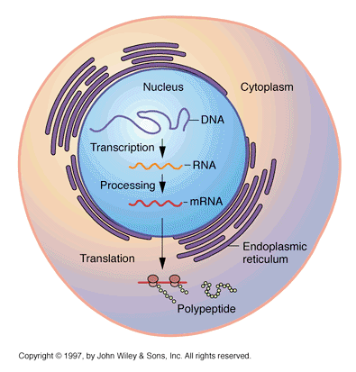
Central Dogma of Molecular Biology
MT: Protein Synthesis

Slide 2
What does Central Dogma mean?
Central = main
Dogma = belief
Ex: Christian Central Dogma: Christians believe there is one God

Slide 3
Central Dogma of Molecular Biology
DNA
mRNA
Protein
Transcription
(occurs in nucleus)
Translation
(occurs on ribosome in cytoplasm)

Slide 4
Central Dogma of Molecular Biology
DNA is used as a template to make mRNA in a process called transcription
The mRNA is then used as a template to assemble a protein in a process called translation
**Only goes in one direction; cannot take a protein and make mRNA or DNA from it

Slide 5
Central Dogma
DNA
mRNA
Protein

Slide 6
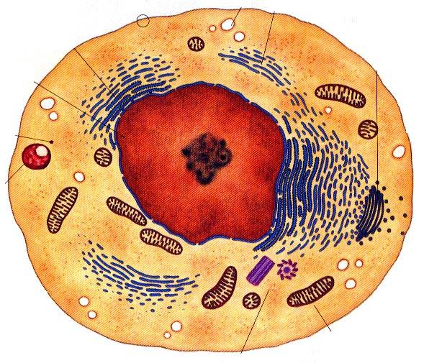
Where does each step occur?
TRANSCRIPTION:
DNA to mRNA
Occurs inside nucleus
TRANSLATION:
mRNA to protien
Occurs on a ribosome in the cytoplasm
Transcription (in nucleus)
Translation (on ribosome)

