Slide 1
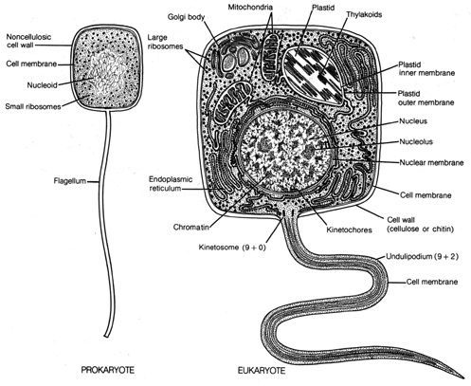
Prokaryote vs. Eukaryote
MT: Cell Processes and Chemical Reactions

Slide 2
Types of cells
Prokaryotes
Eukaryotes

Slide 3
Prokaryote
Size: Small
Cells: uni cellular
No Nucleus
No organelles
Has cytoplasm, cell membrane, and free ribosomes
DNA floating in cytoplasm
Example: bacteria

Slide 4
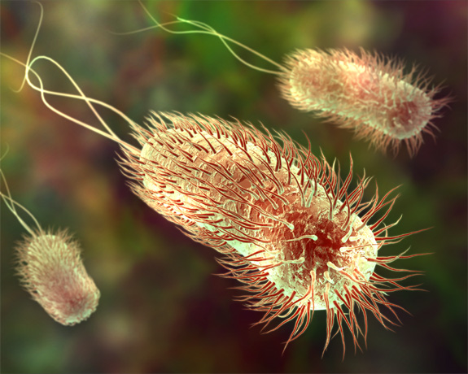
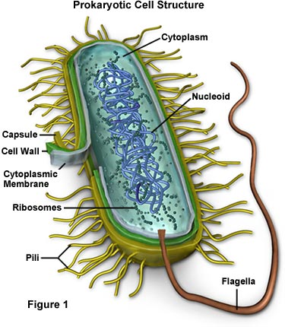
Prokaryote

Slide 5
Eukaryote
Size: large
Cells: mostly multicellular
Has Nucleus
Many organelles
Has cytoplasm, cell membrane, and free ribosomes
DNA floating in nucleus
Example: plants, animals, fungi, protista

Slide 6
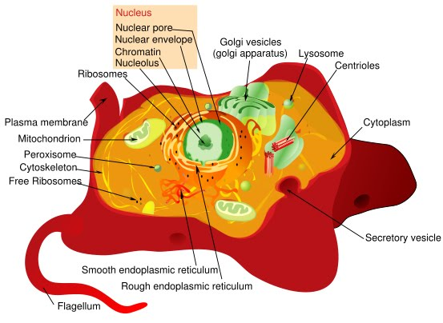
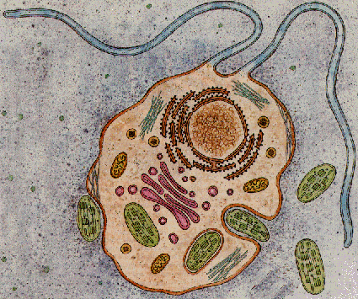
Eukaryote

Slide 7
Which types of cells make up your body?

